Slide 1

Embed PowerFX in your .NET Apps!

Slide 2

Intro
Juan Pablo Tarquino
Software Developer with about 20 years of experience
LinkedIn
https://www.linkedin.com/in/juantarquino
Blog (not updated often ☹ )
https://jptarqu.blogspot.com
Sample repo and slides for this session:
https://tinyurl.com/PowerFX-NET
Notes:
My name is Juan Tarquino, I am software developer with 20 years of experience, mostly .NET and SQL, but I also did some Ruby and Java and even a dialect of Cobol earlier in my career.
Here is my linked in link, if you wish to contact me with questions or comments after the conference, or if you would just like to connect.
The sample GitHub repository for this session is at this link (QR code).
I know is hard to believe but I was not born in this country, so I do have an accent. Please feel free to ask me to repeat or to clarify things if there is something I am not explaining clearly. I will not be offended at all.

Slide 3
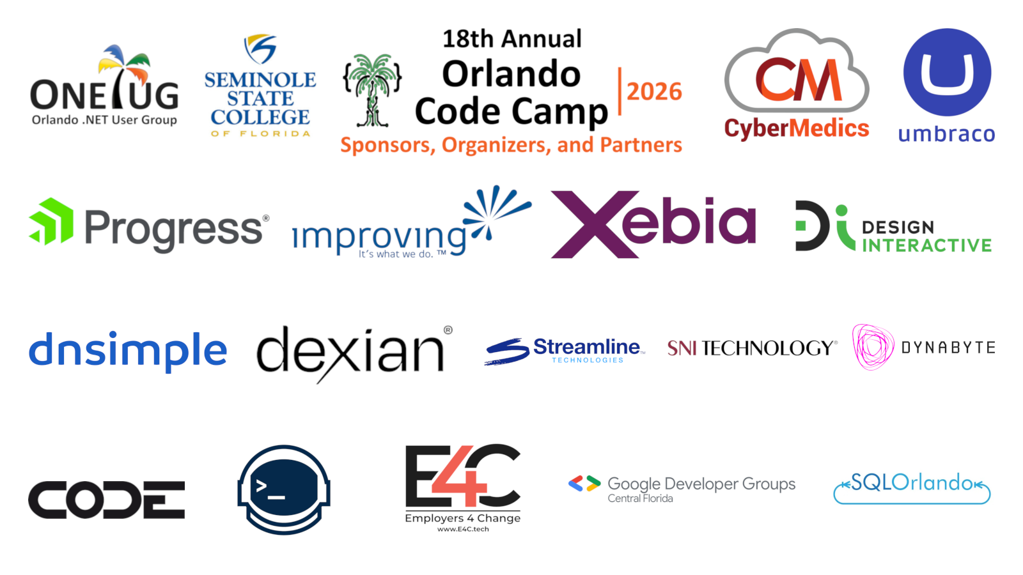
Embed PowerFX in your .NET Apps!

Slide 4
Today’s Talk
Problem scenario
Intro to PowerFX
Why embedding PowerFX is a solution to the problem
How to run the PowerFX interpreter from .NET
How to extend the PowerFX interpreter
Notes:
Today we will talk about how to use PowerFX from a .NET app. But before we move to that we will first go through a pretend scenario that will describe a problem that many Dev teams in the enterprise face.
We will then introduce what PowerFX is and how it can be a solution to the problem stated.
We will then move to how we can embed a PowerFX interpereter from a .net app in order to run PowerFX formulas from .NET.
Finally, we will explore ways we can extend PowerFX by creating custom functions in .NET that can be called from PowerFX.

Slide 5
Once upon a time in Pizzas’R’Us™…
Pizzas’R’Us™ is a small but profitable company, trying to be as nimble as possible, providing pizza services to restaurants and super-markets.
Notes:
We will start our session with a story abut a pretend company and a a fake dev team. This story will help us frame a problem that PowerFX is a good candidate to solve.
Our pretend enterprise is Pizzas’R’Us. A small but profitable company, trying to be as nimble as possible. They provide pizza services to restaurants and super-markets.

Slide 6

Problem scenario
Pizzas’r’us
Small, fast evolving company
Small development team
Alexandria – Lead Dev
Many changes requested from Business Units
Business Units trying to adapt to evolving business environment
The biggest part of the changes are business rule changes
Alexandria feels like the bottleneck
Notes:
Pizza’r’us has a small dev team led by Alexandria. Alexandria is great .NET developer, and her talent has helped the business units achieve many of their goals via the custom apps and jobs she has created for them.
Because of the competitive business environment, the business units have been busy asking Alexandria for changes and new features.
Alexandria has a great reputation with the business side, but she sometimes feels like the bottleneck and wishes their was a way to make those changes faster or for another team to be able to help with the changes.
She notices that the biggest part of those changes have been changes to business rules, as the business is trying to evolve their tactics to gain a competitive advantage.

Slide 7
Business Logic vs Other logic
Business logic is the logic that is unique to the business problem you are trying to solve.
It can be very unique
Examples
Logic to drop a message in a queue is common across industries
Logic that specifies that customers with certain number of purchases get a discount is very specific.
It can be executed in a vacuum with no direct dependencies on external resources
Notes:
We need to talk about what is and what is not Business Logic (aka Business Rules). I will give you my definition that I have found from experience over the years. Business logic is what makes your app helpful to the business. The logic is very specific and very unique because it tries to solve the specific problem your business has.
This logic is not the code you write in order to communicate with external dependencies. It is not the code you write to open a database connection, or drop a message in a queue, or send an email, or even call an HTTP service. It is the code that determine when those things happen and the contents of their payload. For example, the requirement is to notify a customer if their account has an monthly average lower than the average of the previous 12 months. The business logic is the logic that determines the criteria (the average calculations) and the the contents of the message (what will go into the notification). It is not the code that you have to write to access the database to pull the data to calculate the averages, nor it is the code that you use to connect to MS Graph to send the email via Outlook services.
By doing this separation, you are able to test the business logic in more reliable way since you are coding your logic with a explicit separation from your external dependencies. For example, it makes it easier to test that the verbiage of the email will be correct without having to actually send ay emails or fully faking an email service. It also reduces your integration to the bare minimum.
Several architecture styles out there reinforce this notion, for example ports and adapters and the hexagon architecture.

Slide 8
Solution Research
Most requests are for Business rules changes
Business users familiar with Excel
A larger IT team that are not Pro devs, but work in PowerPlatform
PowerApps
PowerAutomate
Notes:
Alexandria starts to engage the Business Units to try to find out what tools they use every day, in an effort find patterns that then she can use to help them with the changes they request.
She observes that many in the the business units are very good Excel users. Many the apps Alexandria created for them had their originins on an Excel file created by business user that then grow into a critical business resource.
She learns that some of the requests from the business go to a larger IT team, different from the Development team. This team uses the Microsoft PowerPlatform to build solutions for the business. However, quite a good part of those requests are too complex or fall outside the skills of that team, so the requests get redirected to the Dev Team to be addressed by custom software.

Slide 9
Solution Space
Business rules engine frameworks
Most are Java based, not a good fit for team
Another paradigm for business users to learn
Microsoft’s Rules Engine
https://github.com/microsoft/RulesEngine
Unfamiliar syntax for existing org
Graphical DSL
Classic Windows Workflows
PowerFX
Notes:
Alexandria starts looking for tools that can assist the business units with coming with solutions to their needs. She finds many applications and frmeworks whose purpose is to define and execute business.
A lot of the software out there for business rules is actually pretty mature, with frameowkrs such as Drools, and Camunda’s DNN. However, as good as those tools are, they are not a good fit for her org because most of those tools are Java based and would require the business units to learn new paradigms and syntaxes.
Alexandria does find that Microsoft has an Open Source engine for .net for rules. Even though this one is based in .net, the syntax is still a little bit unfamiliar to the business.
Another approach she finds is using Windows Workflows as a business friendly to define business logic.

Slide 10
Intro to PowerFX
Business user friendly
Open sourced by Microsoft
Similar to Excel formulas
Use in many parts of the Power Platform
Many Experts, Tutorials, Articles, etc
https://learn.microsoft.com/en-us/power-platform/power-fx/overview
Notes:
According to Microsoft “It's a general-purpose, strong-typed, declarative, and functional programming language.” (Microsoft Power Fx overview - Power Platform | Microsoft Learn)
One of the design goals is to have people think of PowerFX as spreadsheets (https://learn.microsoft.com/en-us/power-platform/power-fx/overview#think-spreadsheet )

Slide 11
PowerFx
Notes:
Alexandria starts looking for tools that can assist the business units with coming with solutions to their needs. She finds many applications and frameworks whose purpose is to define and execute business.
A lot of the software out there for business rules is actually pretty mature, with frameworks such as Drools, and Camunda’s DNN. However, as good as those tools are, they are not a good fit for her org because most of those tools are Java based and would require the business units to learn new paradigms and syntaxes.
Alexandria does find that Microsoft has an Open-Source engine for .net for rules. Even though this one is based in .net, the syntax is still a little bit unfamiliar to the business.
Another approach she finds is using Windows Workflows as a business friendly to define business logic.

Slide 12
Why we should consider using PowerFX from our .NET apps
Tap into the power of PowerFX
Business users already familiar
Answers on how-to already on Internet
Co-pilot support
Execution at runtime add dynamism to your app
Business/Mapping rules
Notes:
Now let’s talk about how this can be combined with .NET. Let’s first talk about “why”. As mentioned before, PowerFx has a popuatr sytbnax with other Microsfot Products out there using it. So the amount of existing knowledge out there makes existing answers available to those who use it.
Adding it to .net will allow you to add logic without potentially having to recompile or redeploy your app because it is an interpreter engine. Although, in real world enterprise scenarios you would still want those PowerFx pieces to go through some sort of lower to upper environment lifexyle, although the lifecyle would be faster and not require a full re-deployment.
The syntax of the language looks familiar to the business side if the business side is familiar with Excel.

Slide 13
How to run the PowerFX interpreter from .NET
Interpreter from Microsoft
https://github.com/microsoft/Power-Fx
Microsoft Samples:
https://github.com/microsoft/power-fx-host-samples
Minimal Sample:
https://github.com/TheJuanitoLearnsShow/EmbedPowerFX-Session
Notes:
Microsoft provides an open-source repo with the .NET PowerFX interpreter. There is also another repo with examples. Going back to our pretent story, Alexandria and her team looked for quick start guide or some other minimal tutorial in the sites but could not find any. What they had to do was to look a that examples and learn from the sample repo how to setup and use PowerFX in .NET. The 3rd link here is a minimal console app with a few methods showcasing the most minimal way of using the Interpreter in .net.

Slide 14
How to run the PowerFX interpreter from .NET
Add NuGet packages
Initialize engine
Add variables and formulas
Must have valid syntax
Language definition in progress:
https://github.com/microsoft/Power-Fx/blob/main/docs/overview.md
Evaluate formulas
Notes:
The first step is to add a reference to the nuget package in your project.
Then, you can create an engine object of type Engine. You can pass options to it, and we will see later that this step allows us to expose .net methods to the interpreter, but for now you can see that it requires no params.
The next step is to define the variables and formulas.
Variables are like variables in other languages, where the vriable has a type and the value of the variable can change through the lifetime of the interpreter engine. As you can see here, we define a variable and we are able to change its value later on. The type of the variable needs to be defined and the type of the type is PowerFX type.
Formulas are basically named expressions. For each formula you give a name and then the valid PowerFX expression that represents the formula. The string is a regular .net string, but the contents of the string need to have a correct PowerFx syntax. Valid syntax includes defining records, tables, PowerFx collection functions, etc. Notice there is no compile time check for the syntax and there is no error when you define a formula with a wrong syntax. At the time of calling "SetFormula", syntax is verified. Invalid expressions will throw an error (show example). Please note what PowerApps could support might not necessarily be what the .NET interpreter can support. Microsoft is building a formal definition document in their repo here, but it is a work in progress as they are taking the PowerApps docs and generalizing them.
Once you have the formulas defined, in order to evaluate them and get their value into the .net world, you need to call one of the evaluate methods in the engine. Notice there is a version for async, we will talk about that later. You can also call "GetFormulaValue“. The value returned by the Evaluate methods are a special PowerFX value. You can interrogate this value to find out what PowerFX tyupe it is. You can also convert it to a generic .NET object type and do something like “ToString()” to get its textual representation. You can use c# pattern matching to get the PowerFX type of the result object from the evaluation.
I wish I could tell you that the engine does no execute the formulas until evaluation, but as we will see when we defne our own methods, there is some sort of execution during the setForumal method.

Slide 15
Demo

Slide 16
Custom Functions
Derive from ReflectionFunction
Base constructor takes in:
Name
Return Type
Param Types
Implement “Execute” method
Function returning:
Primitive
Record
Table
Async functions
Notes:
Let’s pretend the BU of Pizzas’R”Us comes back to Alexandria and say: “ this is really awesome that we can write the business rules in powerfx, but we would like to do things that the PowerFX version you gave us cannot do Business days math”. Alexandria then jumps into research mode to see if there is a way to extend the Interpreter with custom PowerFX functions implemented in .net. With the help of co-pilot, Her reasearch of the repo takes her to the some samples in the official repo. Using those examples, she figures out the following:
To create a custom function for the interpreter, we must:
Create a new class that derives from ReflectionFunction
Need to pass to the base constructor: name of the function, return type, types of parameters.
In this particular example, for our business days add function, we pass the name, the return type of date, and we pass an array with 2 elements specifying that our first parameter is of type date, and the second parameter is a number.
Need to implement the “Execute” method. Notice this is not an override method. The engine will look it up by magic name. The method must return the generic FormulaValue type. The parameters must be the parameters your functions takes, in this case our starting date and the number of days to add.
Within the method we can convert the parameters to .net values using “.Value”. In the body you can then do whatever you need to do in the .net world to come up with the return value, in this case, we are writing normal .net code to add business days to a date using a popular nuget library for holidays.
To return the value, use FormulaValue.New to convert the .net value to an object the Interpreter can use.
We must tell the interpreter engine about the function by registering the function using AddFunction and passing an instance of the custom class.
Then we can call that function as if it were a regular PowerFX function.
You can also, define functions that return a record. For example, Alexandira needs to create a function that takes in a string and parses the string into a well known structure in Pizza r us. The structure contains the id of the customer, the year the customer was onboarded and their unique id in the ERP system. E.g.: “juan#1998
Same as before, but use a RecordType for the return value parameter in the base constructor. You must build the RecordType.
In the body of the execute method we build the record:
Use NamedValue objects for the property-value pairs
Use FormulaValue.NewRecordFromFields to build the record object
As you can see, we can call that function from our powerfx code to get the record. We can access the properties of the record from .net by treating the result of the evaluation as an Expando object, we can can translate its properties to a .net dictionary.
Lastly, you can also have functions that return a table.
As before, we need to derive from ReflectionFunction, but we need to define the type of our table using TableType.Empty() and then call Add(…) to add each of the columns our returned table supports.
We need to then define the record type for each row.
In the execute method, we build each row as a record and then add it to a list.
We can take that list and use FormulaValue.NewTable(RecordType, rows) to build the table value.
You can also define your own TableValue type, but that is out of scope of this session.
So far he have seen functions that operate synchronously, what if you need async? First, I would like to give a general warning that is based on my experience and the learning points from others: when it comes to business logic, if your code (whether is C# or something else) needs async operations, you might be introducing something that does not belong to the business logic of your app. Async code usually (but not always) mean trying to reach to an external dependency. We want our business code to be dependency free in the sense that any input comes from a regular input parameter (the data itself could be obtained asynchronously before the business logic in invoked), same thing with outputs, we do not want our business logic to be the one writing to for example a db or file but rather to prepare the data for whatever integration code is the one putting that final form of the data into a db or file.
To make async functions, you just need to modify the Execute method to return Task<FormulaValue> and must accept a cancellation token as your last param. Within the body of the method you can then do whatever normal async logic you need. In this example, Alexandria is calling some .NET logic to read a file line by line to search for a product name.

Slide 17
Demo

Slide 18
The power of PowerFX in your apps!
PowerFX is a popular, powerful and business friendly language
Microsoft provides an interpreter for .NET
Your app can evaluate PowerFX formulas at runtime

Slide 19

Questions, Questions, Questions???
Best part of sessions like this one ☺
LinkedIN: https://www.linkedin.com/in/juantarquino
Sample repo and slides for this session:
https://tinyurl.com/PowerFX-NET
Feedback:

Slide 20

Thank you! Win something at the raffle!

